Slide 1
Fall Update 5
Dev Bhatia
Ultrafast Optics Laboratory
Boston University

Slide 2
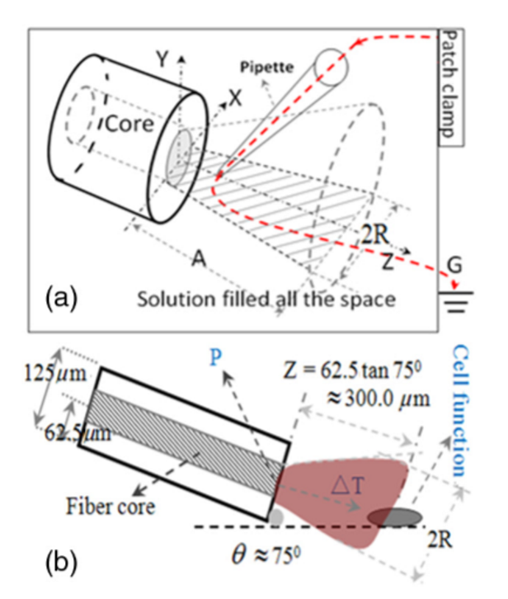
Open Pipette Method for ADTR Measurement [1]
Rapid temperature measurement technique at the micron scale
Carried out by using a microamp current amplifier
Synchronized laser irradiation would cause a local temperature change
This would induce a resistance variation in the pipette
The measured pipette resistance was calibrated as a function of the ADTR
Fig 1. Open Pipette Method & The Geometric Relationship

Slide 3
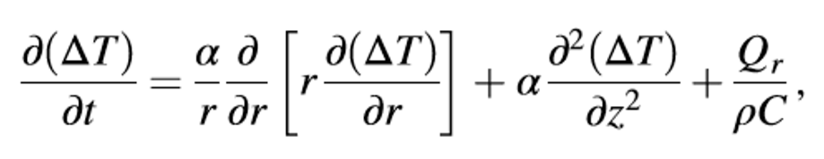
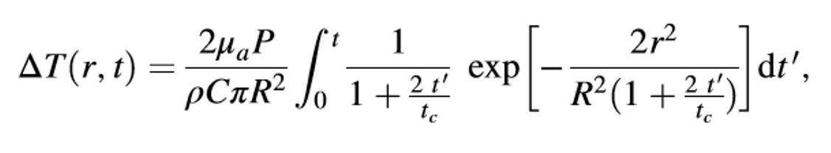
Theoretical Calculation of the ADTR [1]
Eq. 1 –
Mathematical Model of Heat Conduction Equation
Eq. 2 –
Equation 1 solved using a Gaussian approximation. ΔT obtained in consideration of the thermal lens effect
Equation 2 predicted a linear relationship between the laser power and ΔT.
This deduction was confirmed via an open pipette method to measure the ΔT directly
980-nm wavelength infrared laser irradiation

Slide 4



Variable Considerations [1]
μa = 73.9 cm^-1 Optical Absorption Coefficient
R = 25 μm Beam waist at axial distance
z = 117.55 μm Axial Distance
tc = .00109 s Characteristic time of the thermal lens
Po = .00483 W Initial laser power
κ = 0.6 W/mK thermal conductivity
ρ = 1000 kg/m^3 density of saline
c = 4188 J kg^-1 K^-1 heat capacity
r = 25 μm radius of the fiber core
ρ = resistivity determined by the open pipette
γ = conductance of pipette
T = temperature
γo = solution conductance at To
αT = temperature coefficient of solution conductance

Slide 5
Computed Values
Parameter | Calculated Value
Power at the Sample Plane | 2.9mW or 5.5mW
Beam Radius at the Sample Plane | 25.18 um
Beam Radius at the Waist | 25 um
Sample Plane Position (z-distance) | 117.55um
Characteristic Thermal Time Constant | 110.54um

Slide 6
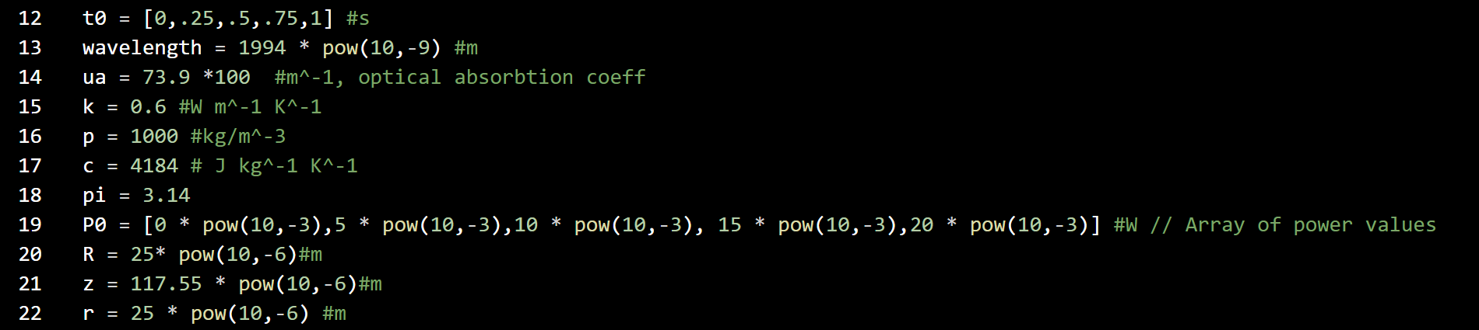
Implementation Strategy - Declarations
Fig 2.
Variable Declaration in Python
Important Considerations:
Array P0 contains initial power values
Will be turned into irradiation laser power
Laser fiber is perpendicular to the axon
Laser is perfectly columnated

Slide 7
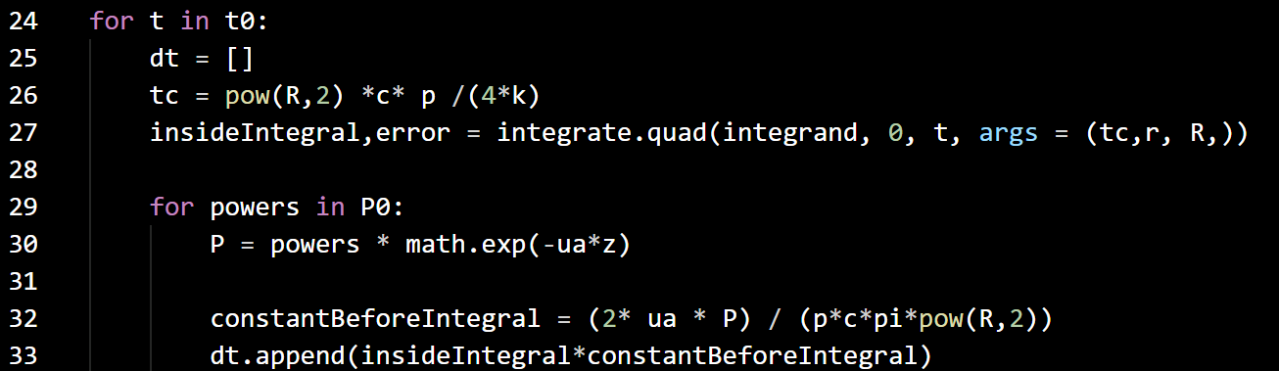
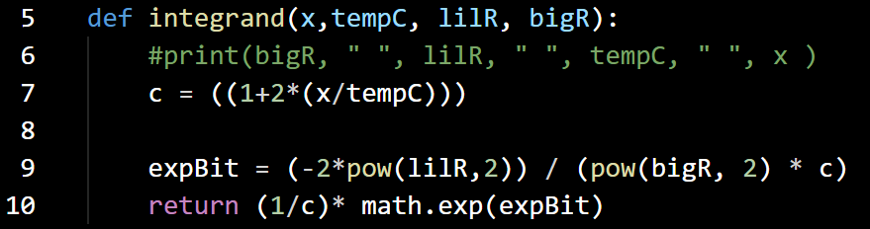

Implementation Strategy – Integration & Loop
Fig. 3 – Computation of Temperature delta with variable Power

Slide 8
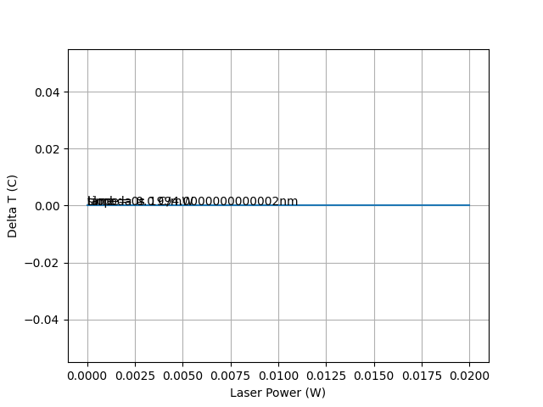
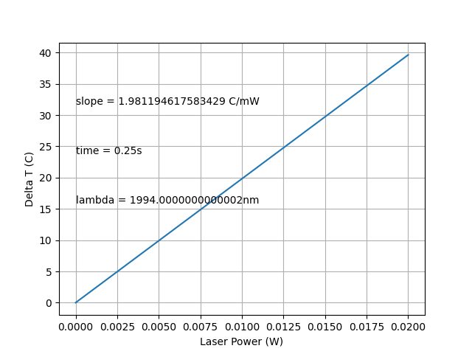
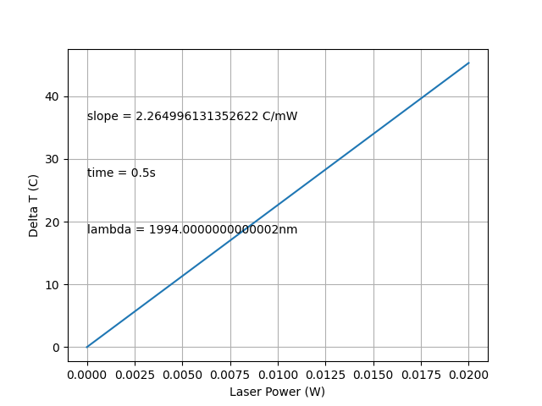
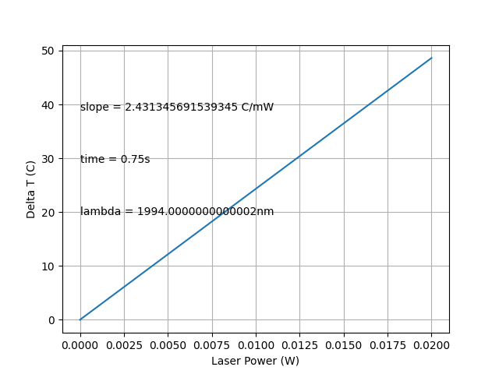
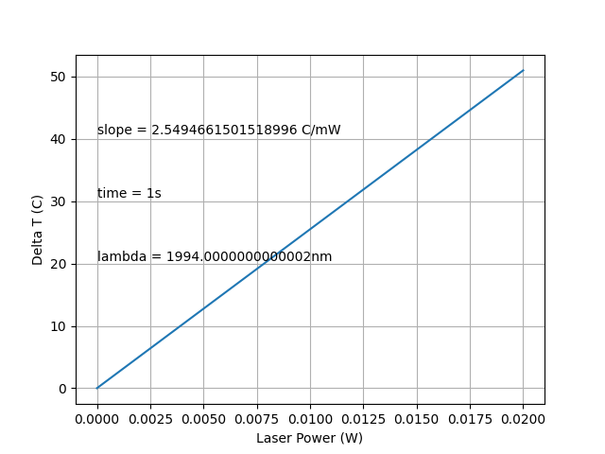
Equation Implementation Results
A
B
C
D
E
Fig. 4 – Graphical Depiction of ΔT with respect to laser power

Slide 9
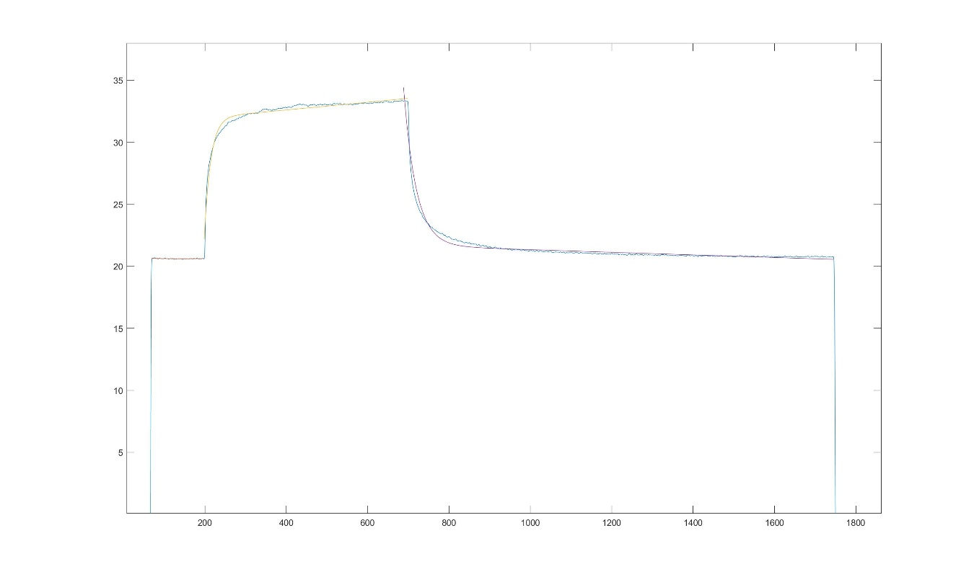
Experimental Temperature Data
Fig 5. Complete Temperature Depiction using Matlab

Slide 10
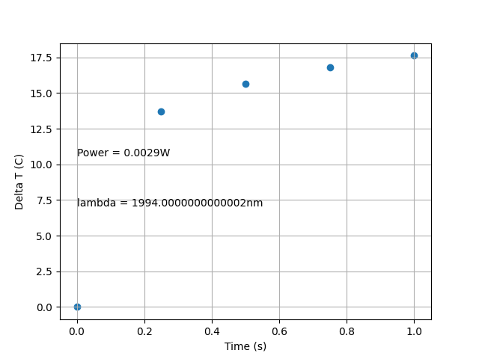
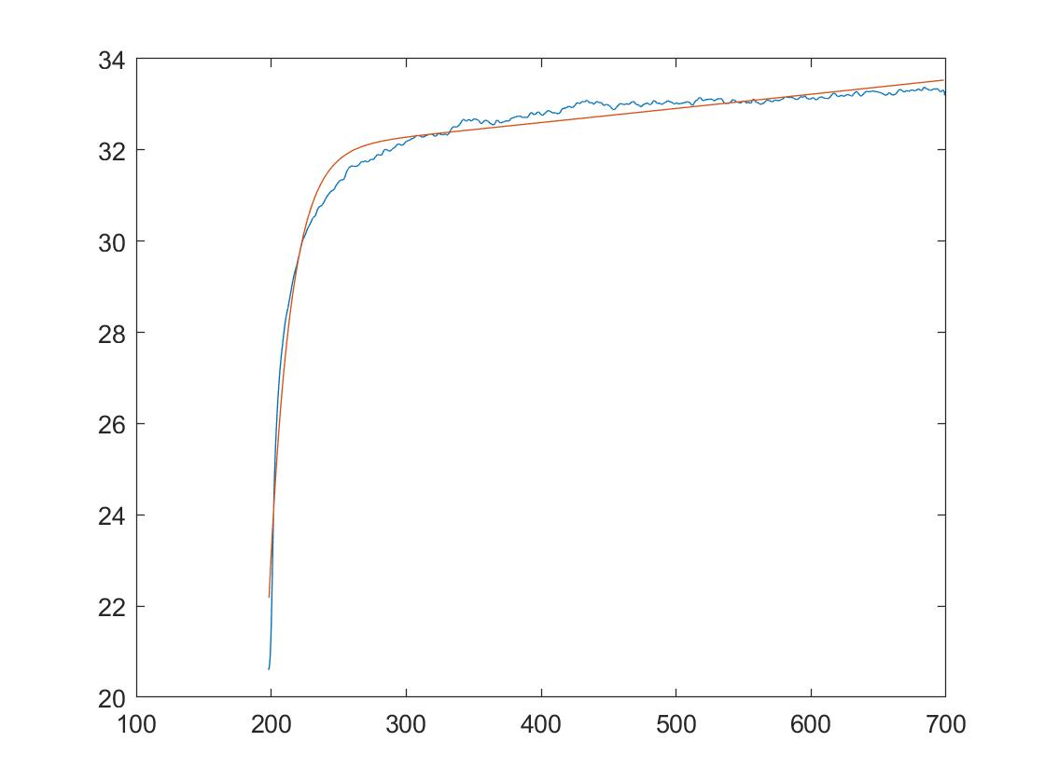
Comparison to Temperature Data
a
b
Fig. 6 – Peak temperature delta at independent times (a), experimental temperature transient (b)

Slide 11
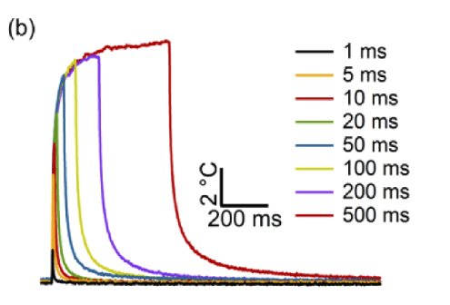
Conclusions
Shown previously is the peak temperature delta at independent times
Different metric to the experimental data – shown in Fig. 5
Slope of the lower time regimes demonstrates a slower increase in temperature
May be a symptom of the equation being used for modeling
Less Stabilization at higher regimes
Fig. 7 – Representative temperature transient

Slide 12
Next Steps
Fix the Pulse Width, explore the creation of a temperature transient
Alter other variables, see how big of a role they play on modeling
Find alternative model equations that lead a more accurate result
If the first bullet point is successful, this may not be needed

Slide 13
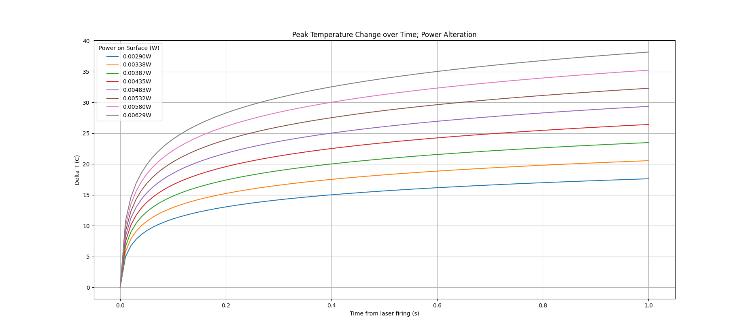
Temperature Transient - Power
Fig. 8

Slide 14
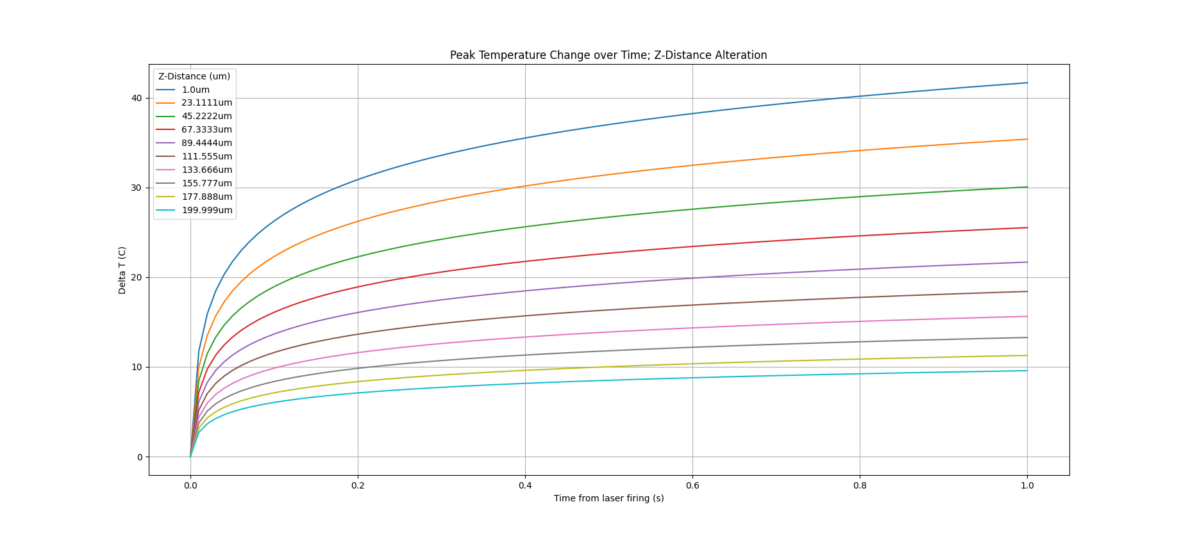
Temperature Transient – Z Distance
Fig. 9

Slide 15
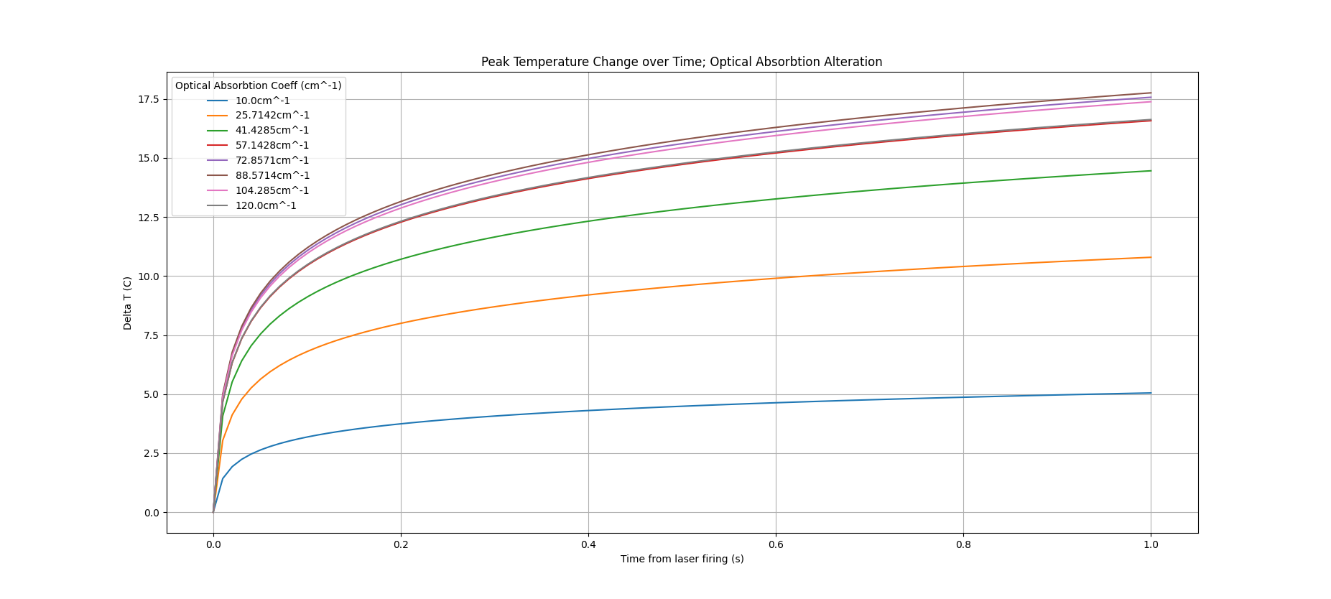
Temperature Transient – Optical Absorption Coefficient
Fig. 10

Slide 16
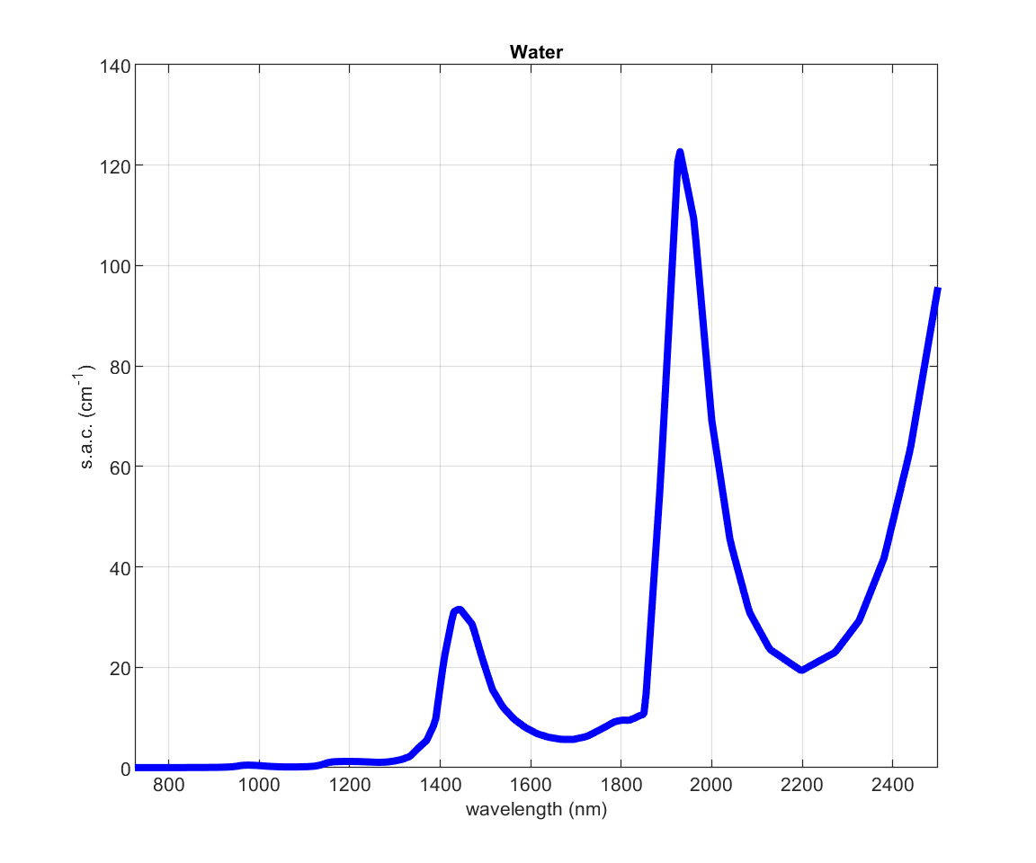
Optical Absorption Coefficient
Figure 11 –
Specific absorption coefficient of water (725-2500nm) linearly interpolated from original data with a resolution of 5nm

Slide 17
Conclusions
Altering base parameters (z-distance, power, optical absorbtion) did not fix the issues with steepness/plateauing
Certain combinations may yield promising results – combinations of higher z-distances with higher powers could change the model
It may be time to explore alternative models

Slide 18
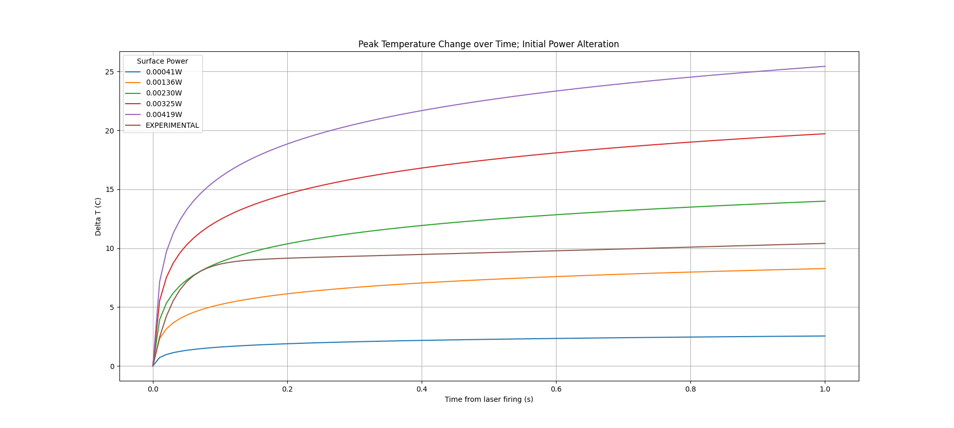
Temperature Transient – Power with Experimental
Fig. 12

Slide 19
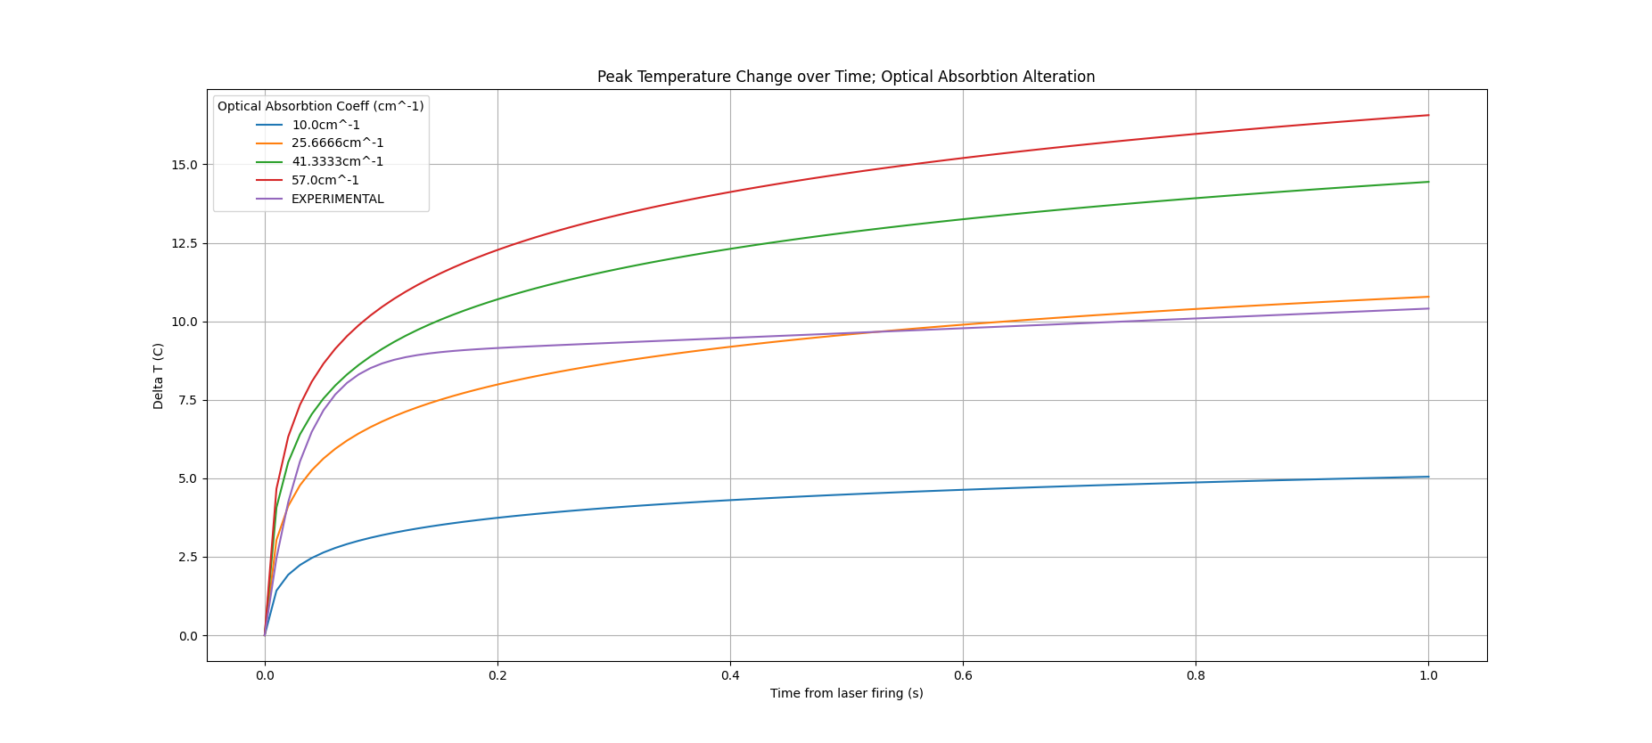
Temperature Transient – OAC with Experimental
Fig. 13

Slide 20
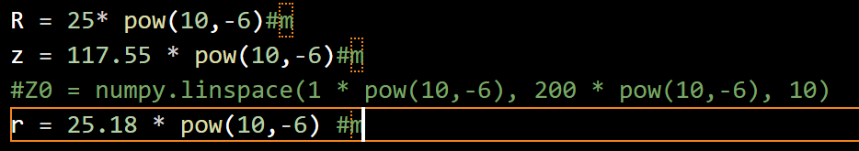
Temperature Transient – z distance with Experimental
In the original program, R is not set to vary with z
An equation is needed for the gaussian model used
Fig. 14 – Axial distance, fiber radius, and spot size

Slide 21
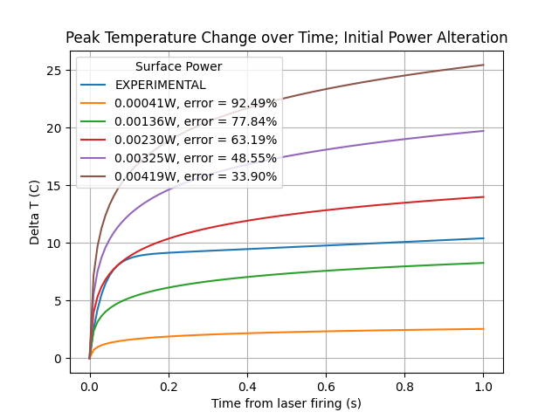
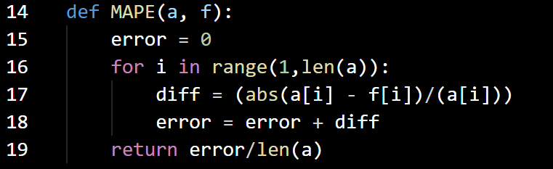
Error
Using the mean absolute percentage error, an attempt is made to calculate the error between the experimental data and the calculated power values
There exists some fixable carryover, considering the general trend of the error
The calculation is shown below -
Fig 15 – MAPE Calculation, power alteration with MAPE

Slide 22
Final Update

Slide 23
Temperature-Dependent Parameters of Saline
Density, Heat Capacity, and Thermal Conductivity all vary with the salinity of the solution
Increasing salinity yields –
Lower heat capacity (c)
Lower thermal conductivity (k)
Increased density (p)
Solution contains 195 mM NaCl ~= 1% NaCl
This corresponds with the following –
Density = 1010 kg/m^3
Heat Capacity = 4150 J/ kg*K
Thermal Conductivity = .584 W / (mK)

Slide 24
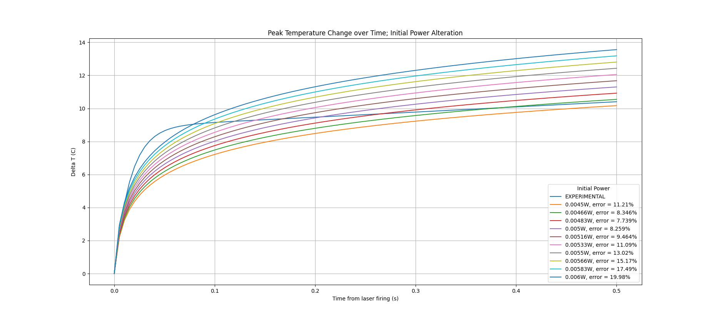
Temperature Transient – Power with Experimental

Slide 25
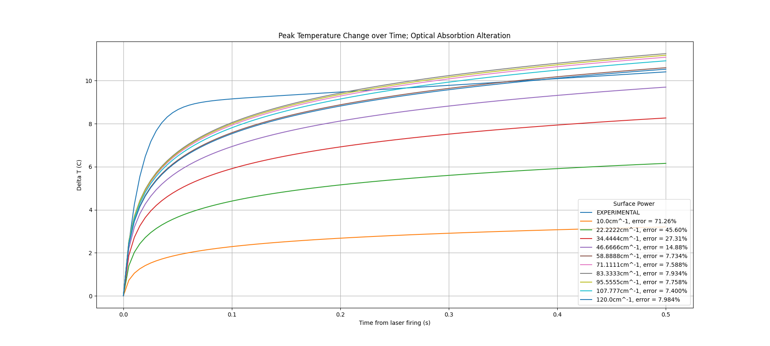
Temperature Transient – OAC with Experimental
Optical Absorption Coeff

Slide 26
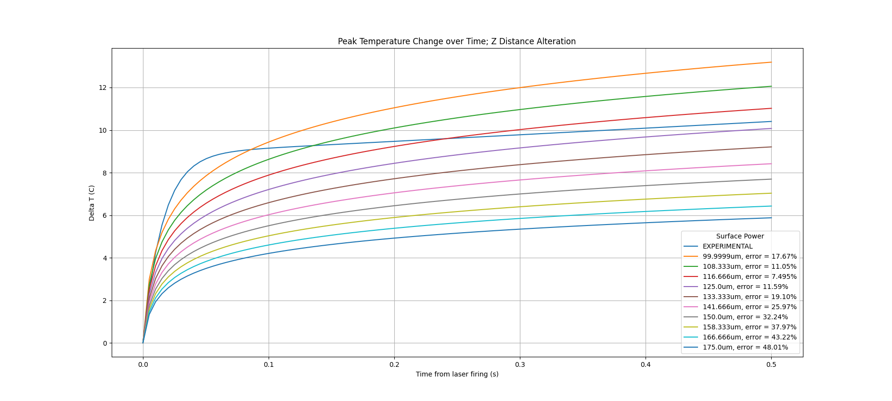
Temperature Transient – Z Distance with Experimental
Z-Distance

Slide 27
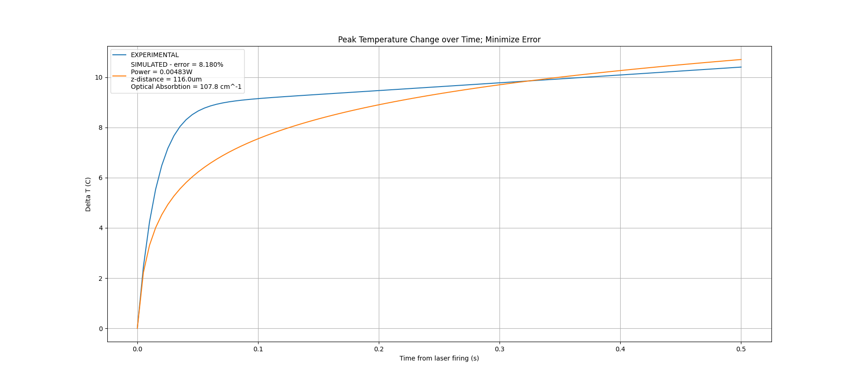
Simulated Curve Using Lowest Error Parameters

Slide 28
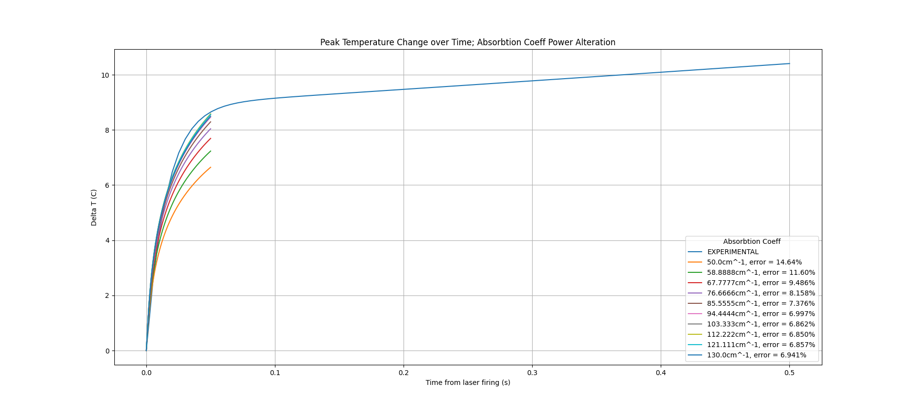
First 50 ms -> Altering Optical Aborbtion

Slide 29
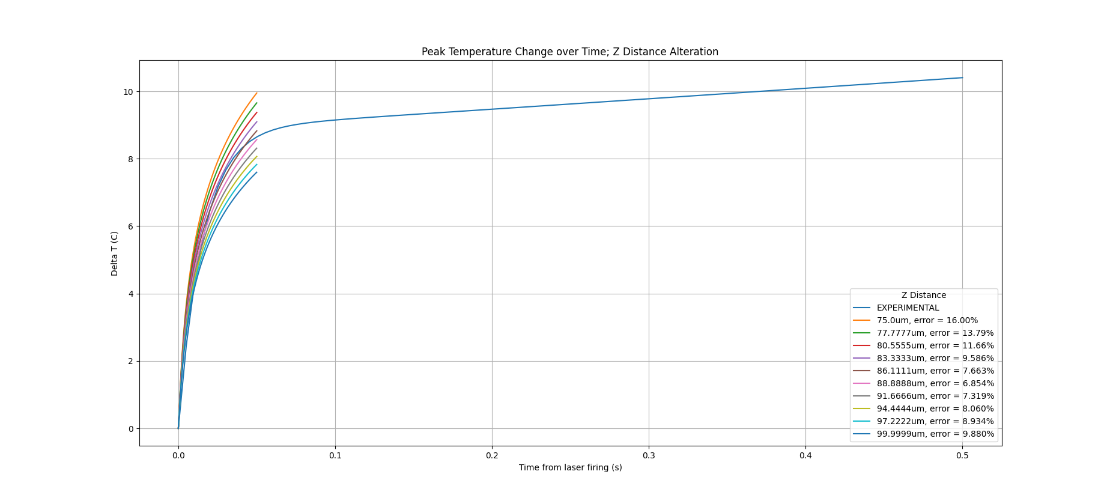
First 50 ms -> Altering Z-Distance

Slide 30
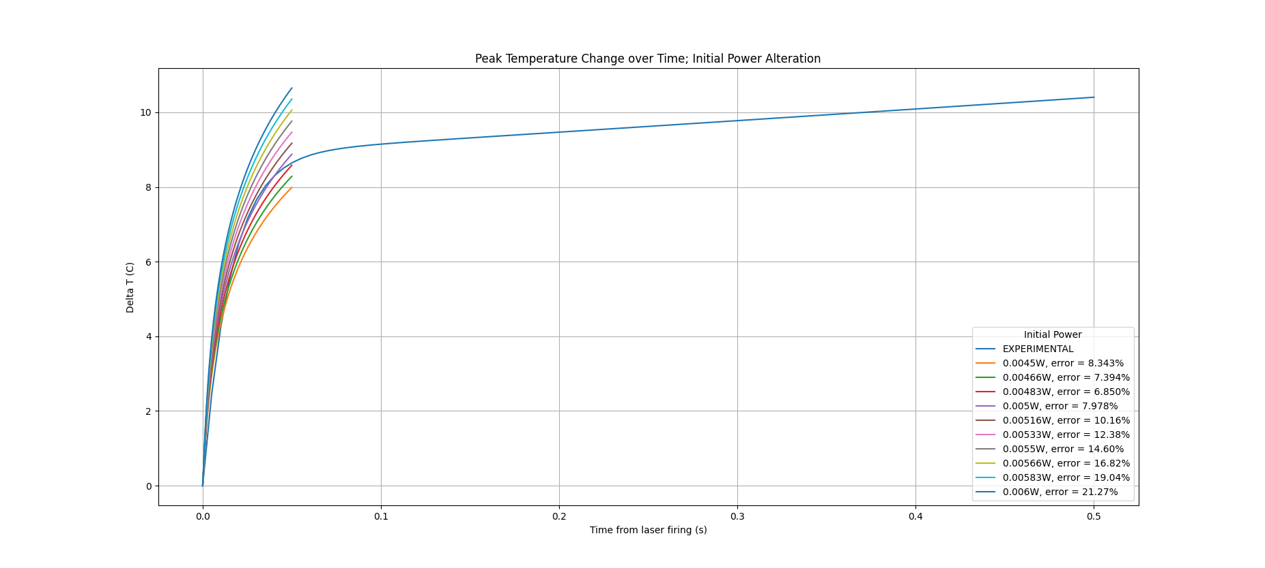
First 50 ms -> Altering Power

Slide 31
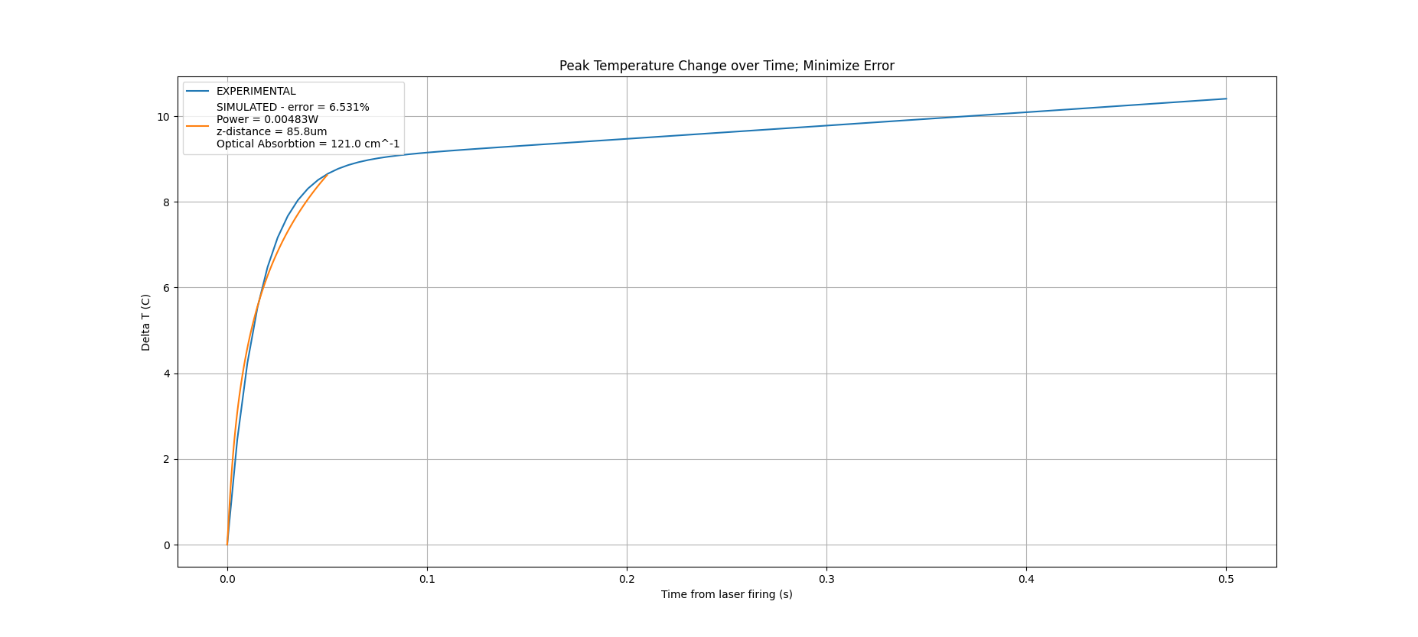
First 50 ms -> Overall

Slide 32
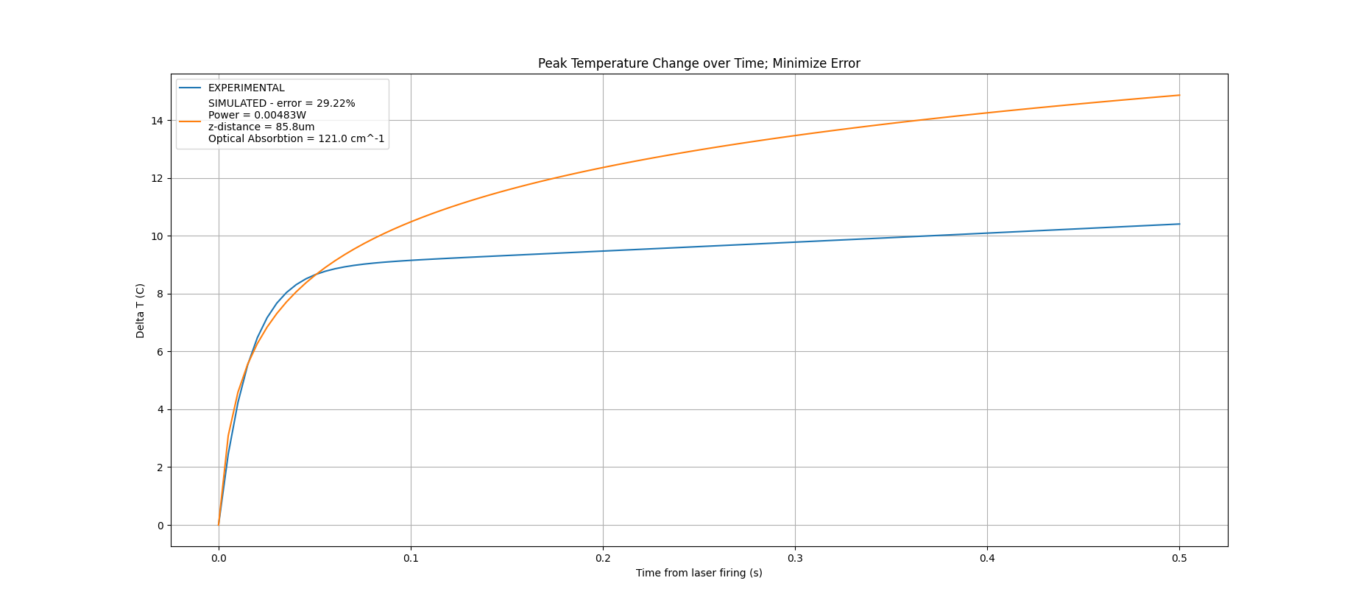
First 50 ms -> Overall Expanded

Slide 33
Final Conclusions
Lowering the error percentage would require splitting the equation at 50ms
This would have unforeseen consequences when simulating with different parameters
The original implementation of this equation sought to demonstrate the linear relationship between laser exposure and delta T
A new equation could be rapidly implemented due to the modularity of the current program

Slide 34
Sources
K.F. Palmer and D. Williams, Optical Properties of water in the near infrared, Journal of the Optical Society of America, V.64, pp. 1107-1110, August, 1974
Zhu, Xuedong, Jen-Wei Lin, and Michelle Y Sander. "Infrared Inhibition and Waveform Modulation of Action Potentials in the Crayfish Motor Axon." Biomedical Optics Express 10, no. 12 (2019): 6580-6594.
Li, Xinyu, Jia Liu, Shanshan Liang, and Changsen Sun. "980-nm Infrared Laser Modulation of Sodium Channel Kinetics in a Neuron Cell Linearly Mediated by Photothermal Effect." Journal of Biomedical Optics 19, no. 10 (2014): 105002-105002.

Slide 35
Sources
Sodium Chloride and Water. (n.d.). Retrieved December 11, 2020, from https://www.engineeringtoolbox.com/sodium-chloride-water-d_1187.html
http://webserver.dmt.upm.es/~isidoro/bk3/c07sol/Solution%20properties.pdf

